Slide 1

XGBoost Explained (eXtreme Gradient Boosting)
Dr. Risman Adnan Mattotorang
Telkom University

Slide 2
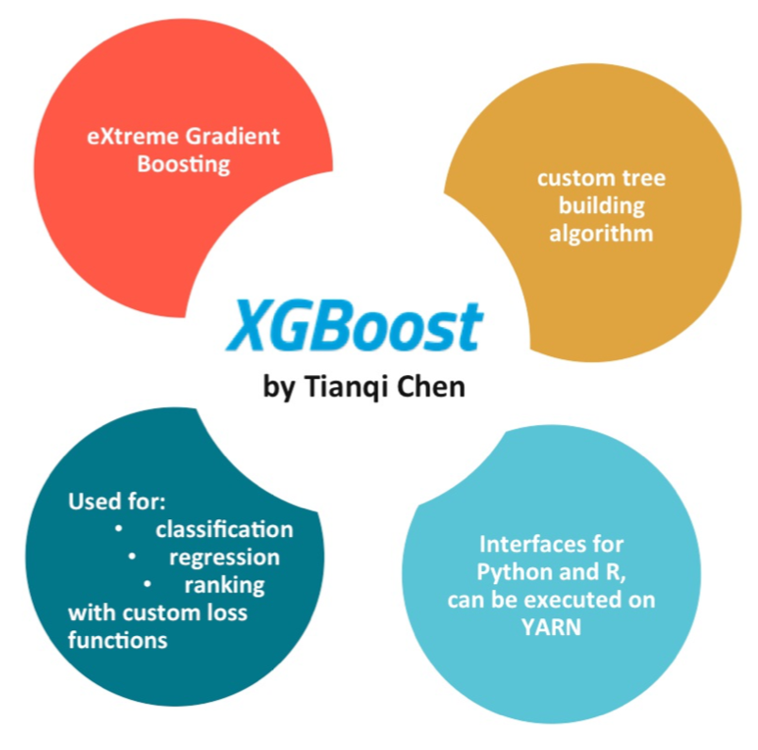
What is XGBoost
XGBoost = CART ensemble model
Scalable ML system for tree boosting
Widely used in Kaggle Competition
Can be used to handle sparse data
Guide: Focus on high level concepts.
Detail algorithm is on paper but ….
Better focus on using the library
This lecture is to explain how tree boosting works before you hack it ☺

Slide 3
Key Concepts
Supervised Learning
Separation of Model, Parameters, Objective Function, Regularization
Generalization Trade Off (VC Dimension and Bias-Variance)
Decision Tree and CART Ensemble Model
Gradient Boosting Algorithm
Exact Greedy Algorithm
Sparsity-Aware Split Finding
Pruning and Regularization
Summary

Slide 4
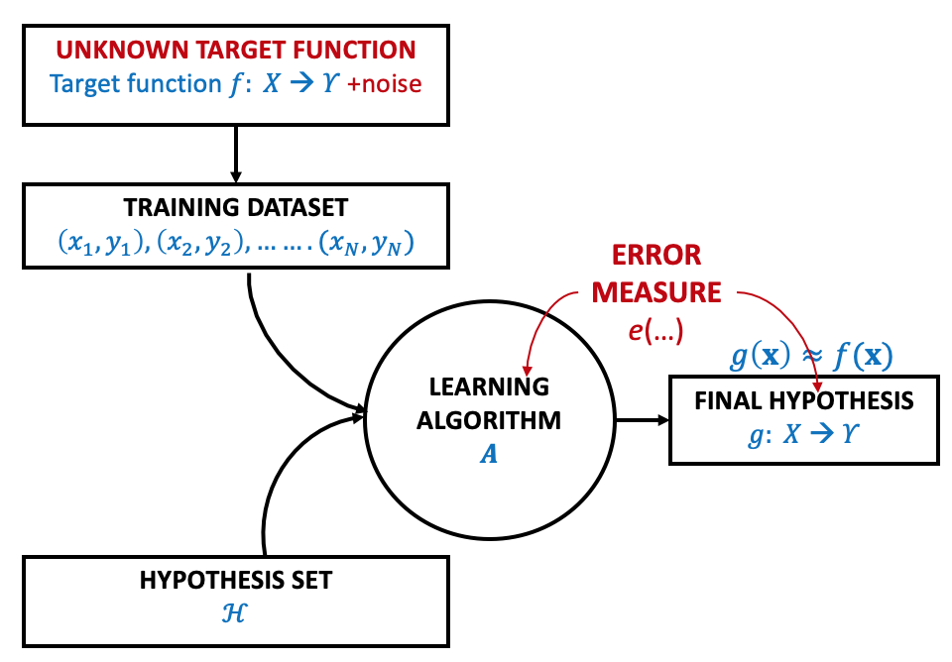
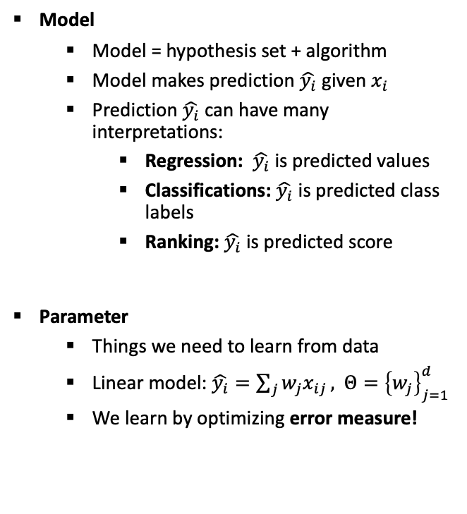
Supervised Learning Problem
Model
Model = hypothesis set + algorithm
Model makes prediction $\hat{y_{i}}$given $x_{i}$
Prediction $\hat{y_{i}}$ can have many interpretations:
Regression: $\hat{y_{i}}$ is predicted values
Classifications: $\hat{y_{i}}$ is predicted class labels
Ranking: $\hat{y_{i}}$ is predicted score
Parameter
Things we need to learn from data
Linear model: $\hat{y_{i}}=\sum_{j}{w_{j}x_{ij}},$ $Θ={\left\{w_{j}\right\}}_{j=1}^{d}$
We learn by optimizing error measure!
Ref: Learning from Data, Yasser Abu-Mustafa

Slide 5
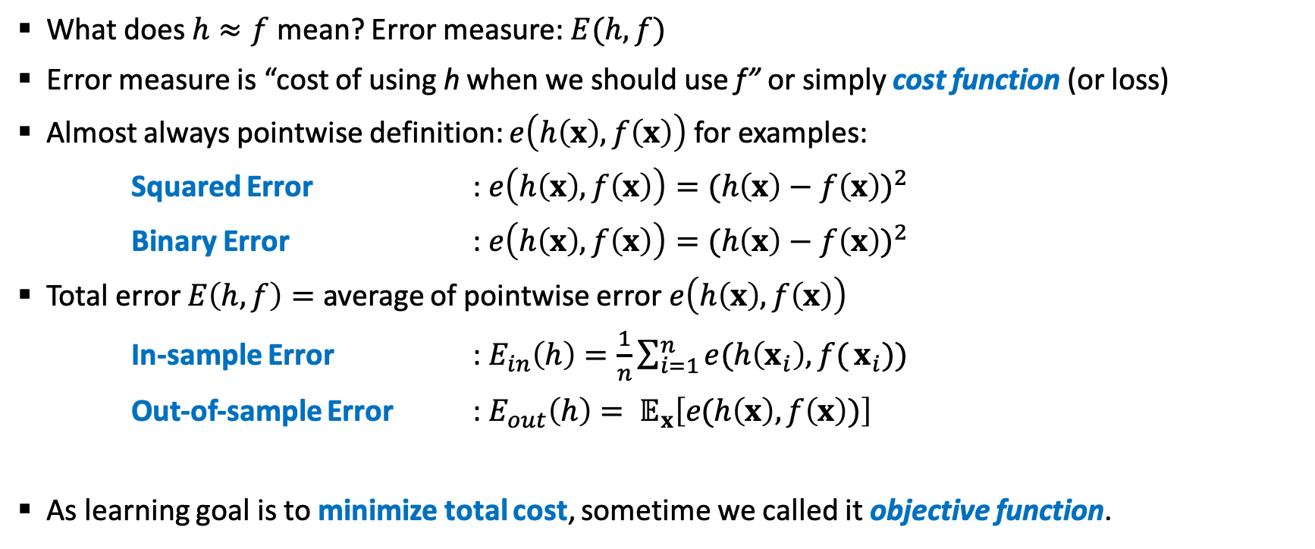
Error Measure vs Objective Function
What does $h≈f$ mean? Error measure: $E(h,f)$
Error measure is “cost of using h when we should use f” or simply cost function (or loss)
Almost always pointwise definition: $e\left(h\left(x\right), f\left(x\right)\right)$ for examples:
Squared Error : $e\left(h\left(x\right), f\left(x\right)\right)={(h\left(x\right)−f\left(x\right))}^{2}$
Binary Error : $e\left(h\left(x\right), f\left(x\right)\right)={(h\left(x\right)−f\left(x\right))}^{2}$
Total error $E\left(h,f\right)=$ average of pointwise error $e\left(h\left(x\right),f\left(x\right)\right)$
In-sample Error : $E_{in}\left(h\right)=\frac{1}{n}\sum_{i=1}^{n}{e(h\left(x_{i}\right),f(}x_{i}))$
Out-of-sample Error : $E_{out}\left(h\right)= 𝔼_{x}\left[e(h\left(x\right), f\left(x\right))\right]$
As learning goal is to minimize total cost, sometime we called it objective function.

Slide 6
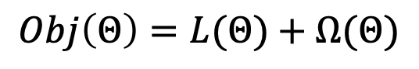
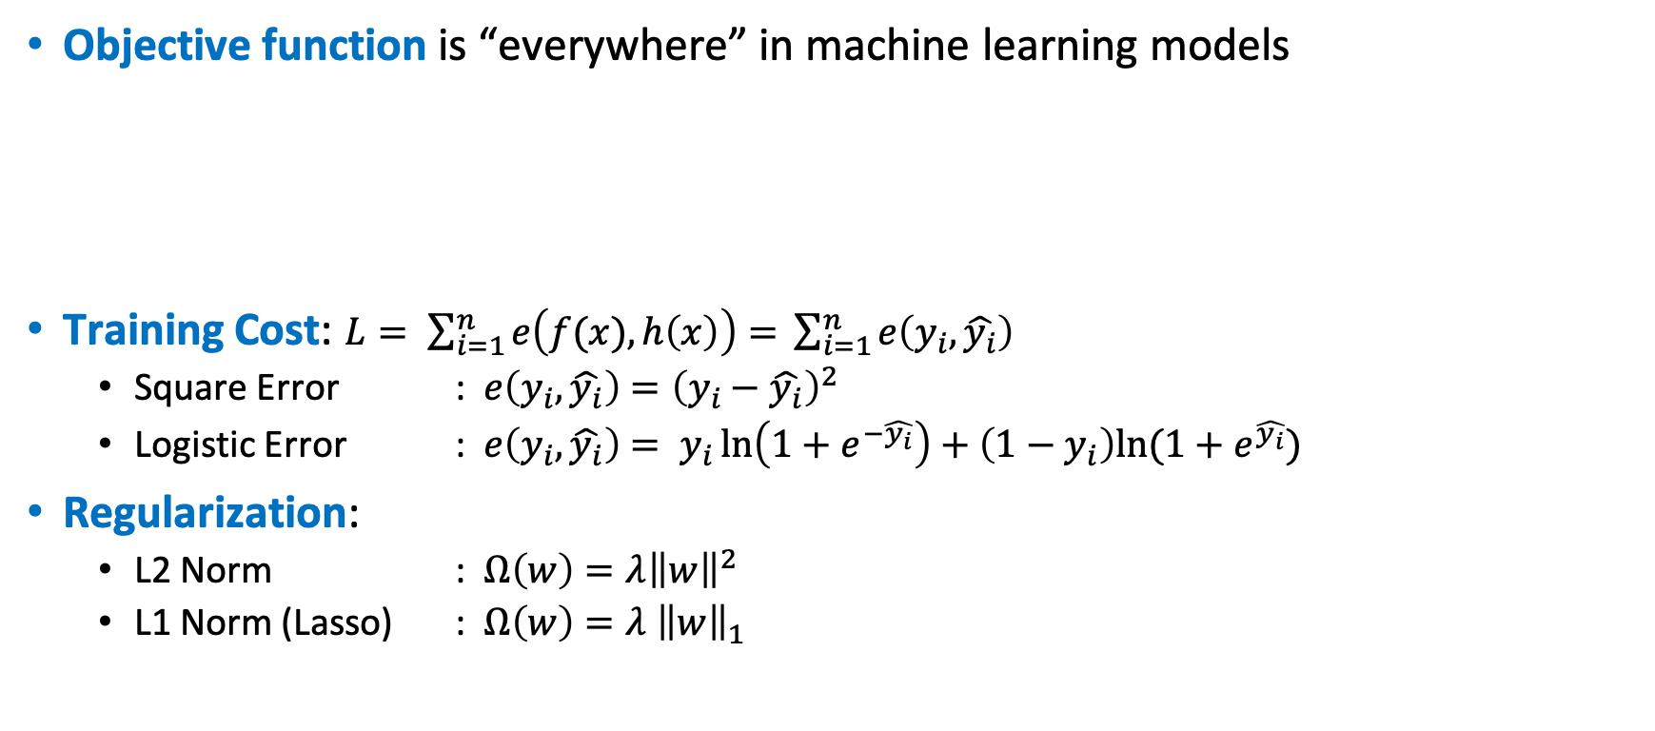
Objective Function
Objective function is “everywhere” in machine learning models
Training Cost: $L= \sum_{i=1}^{n}{e\left(f(x), h\left(x\right)\right)= }\sum_{i=1}^{n}{e\left(y_{i},\hat{y_{i}}\right) }$
Square Error : $e\left(y_{i},\hat{y_{i}}\right)={\left(y_{i}−\hat{y_{i}}\right)}^{2}$
Logistic Error : $e\left(y_{i},\hat{y_{i}}\right)= y_{i}\ln\left(1+e^{−\hat{y_{i}}}\right)+\left(1−y_{i}\right)ln⁡(1+e^{\hat{y_{i}}})$
Regularization:
L2 Norm : $Ω\left(w\right)=λ{\left\|w\right\|}^{2}$
L1 Norm (Lasso) : $Ω\left(w\right)=λ {\left\|w\right\|}_{1}$
$$Obj\left(Θ\right)=L(Θ)+Ω(Θ)$$
Training cost measures how well model fit on training data
Regularization measures complexity of the models

Slide 7
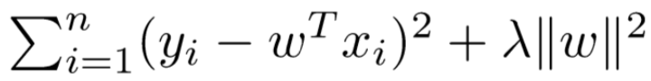

Conceptual Examples
Ridge Regression:
Linear model, square cost, L2 regularization
Lasso Regression:
Linear model, square cost, L1 regularization
Logistic Regression:
Linear model, logistic cost, L2 regularization
Engineering: Define Objective (Cost, Regularization) and Optimize (Eq. SGD).
Notes:
Define objective (loss, regularization), and optimize it!!

Slide 8
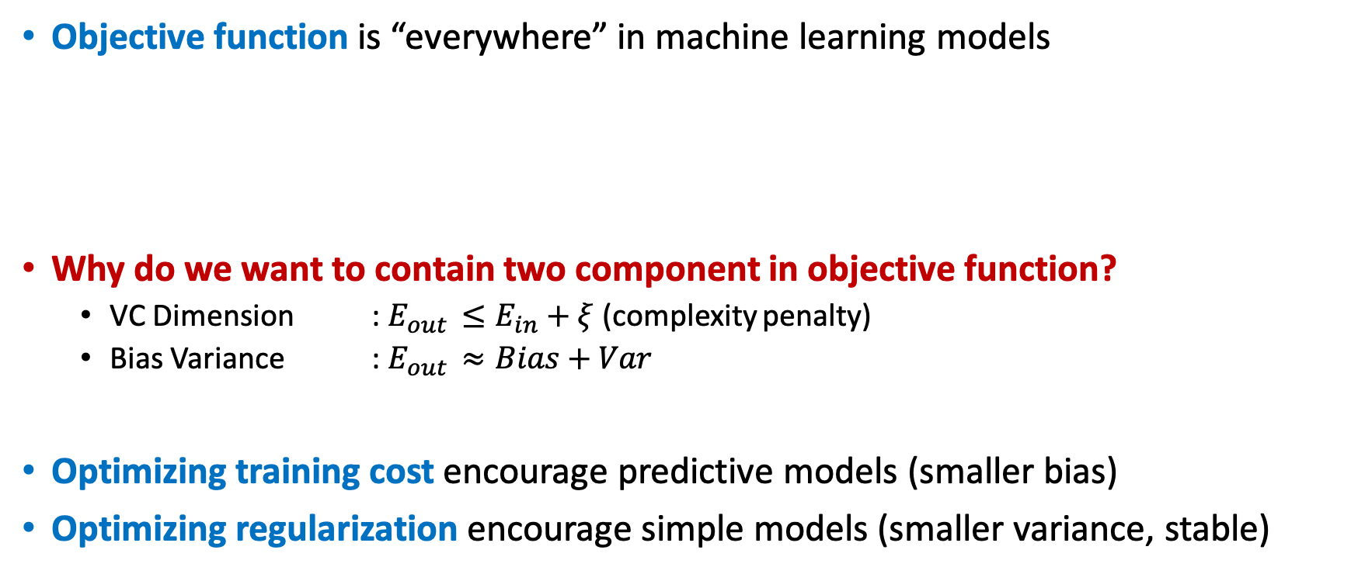
Generalization Trade Off
Objective function is “everywhere” in machine learning models
Why do we want to contain two component in objective function?
VC Dimension : $E_{out }≤E_{in}+ξ$(complexity penalty)
Bias Variance : $E_{out }≈Bias+Var$
Optimizing training cost encourage predictive models (smaller bias)
Optimizing regularization encourage simple models (smaller variance, stable)
$$Obj\left(Θ\right)=L(Θ)+Ω(Θ)$$
Training cost measures how well model fit on training data
Regularization measures complexity of the models

Slide 9
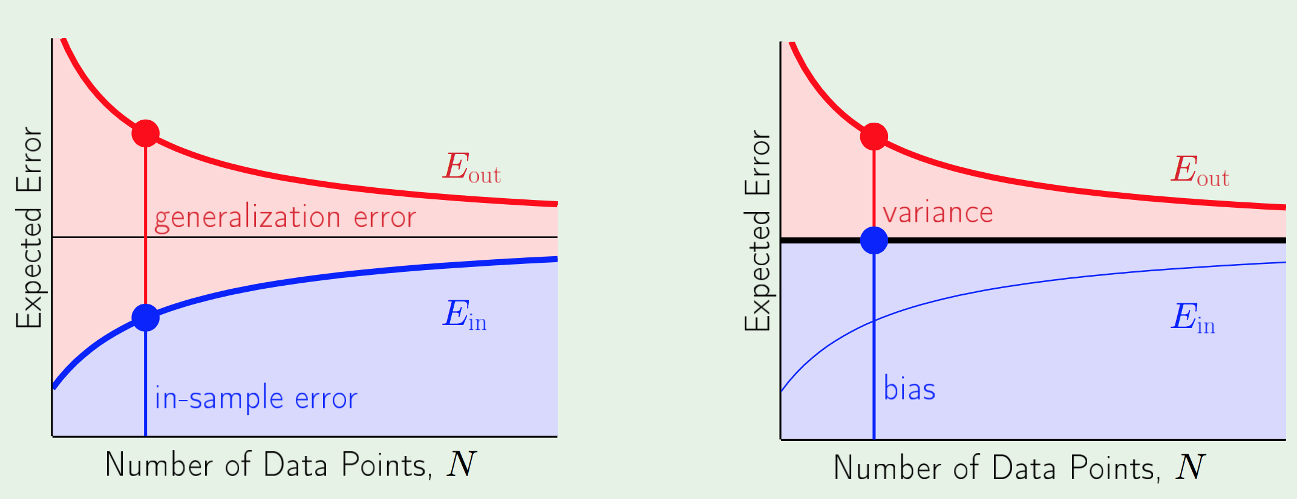
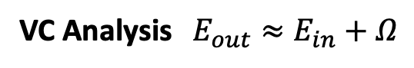
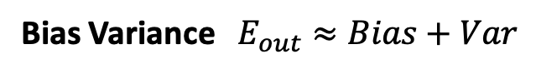
VC and Bias-Variance Trade Off
VC Analysis $E_{out}≈E_{in}+Ω$
Bias Variance $E_{out}≈Bias+Var$

Slide 10
Key Concepts
Supervised Learning
Separation of Model, Parameters, Objective Function, Regularization
Generalization Trade Off (VC Dimension and Bias-Variance)
Decision Tree and CART Ensemble Model
Gradient Boosting Algorithm
Exact Greedy Algorithm
Sparsity-Aware Split Finding
Pruning and Regularization
Summary

Slide 11
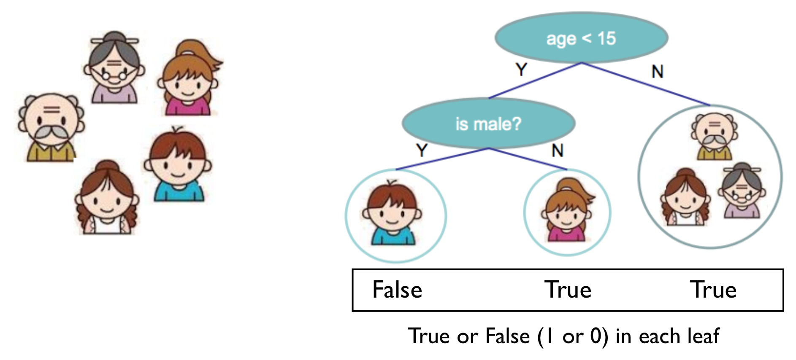
Decision Tree
Input: BMI, Age, Sex
Output: Has Diabetes?

Slide 12
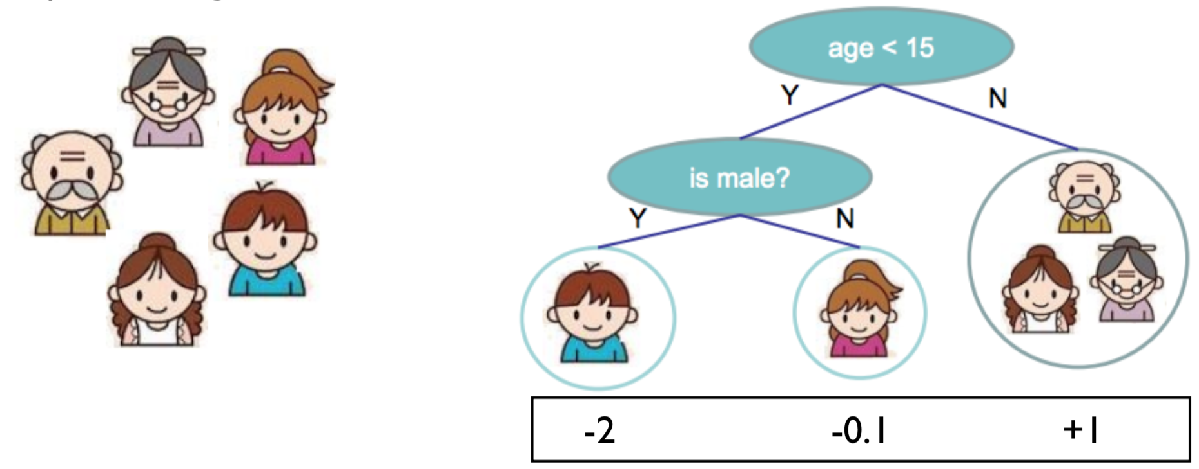
CART
CART = Classification and Regression Tree
Decision rules same as decision tree
Contains one score in each leaf value.
Think: A function that maps the attributes to the score.
Input: BMI, Age, Sex
Output: Has Diabetes?

Slide 13
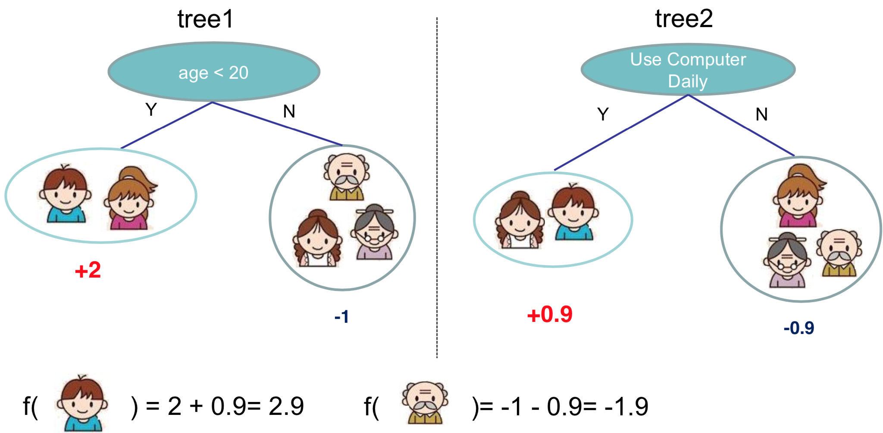
CART Ensemble Model
Input: age, gender, occupation.. Output: Like Minecraft?
Ensemble: Use multiple models to get better performance. Expand Hypothesis Set.
Example: Bagging and Boosting (Such as XGBoost)
Benefits of Ensemble
Widely used GBM, Random Forest, etc.
Invariant to scaling of input.
Don’t need features normalization
Learn higher order interaction of features
Scalable and are used in industry

Slide 14
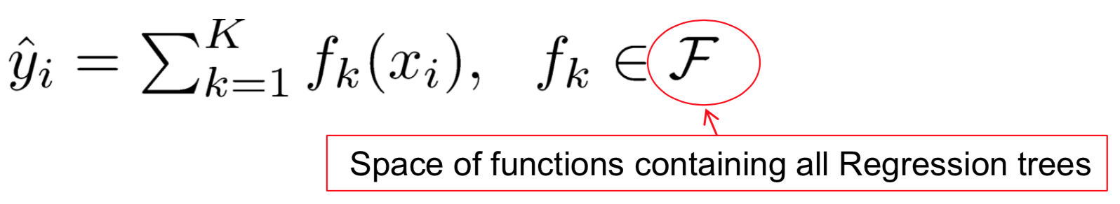
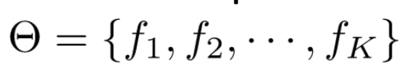
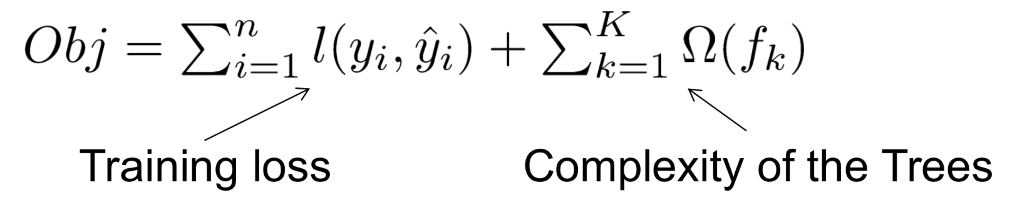
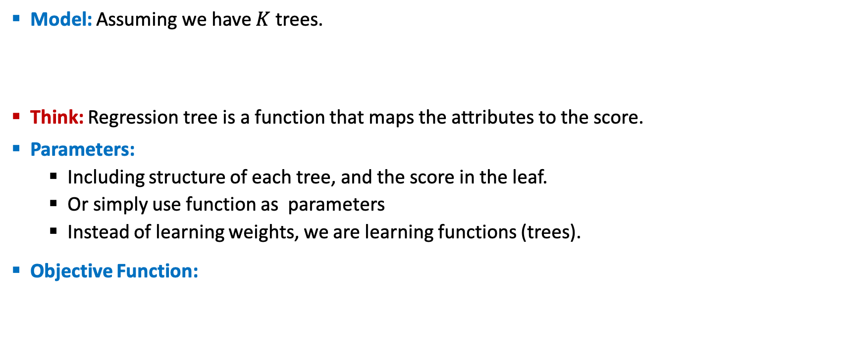
Objective Function Formulation
Model: Assuming we have $K$ trees.
Think: Regression tree is a function that maps the attributes to the score.
Parameters:
Including structure of each tree, and the score in the leaf.
Or simply use function as parameters
Instead of learning weights, we are learning functions (trees).
Objective Function:

Slide 15
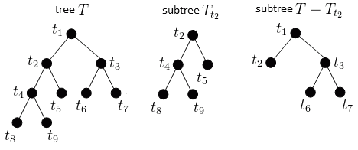

Complexity of CART Ensemble
Possible and obvious ways:
Number of nodes in tree, depth, etc
Heuristic view of complexities:
Split by information gain
Prune the tree
Maximum depth
Smooth the leaf values
Theoretical view of complexities:
Training cost/loss
Regularization defined by #nodes
Constraint on function space
L2 regularization of leaf weight
Training Cost + Regularization objective pattern applies for CART ensemble model. But how do we learn it?

Slide 16
Key Concepts
Supervised Learning
Separation of Model, Parameters, Objective Function, Regularization
Generalization Trade Off (VC Dimension and Bias-Variance)
Decision Tree and CART Ensemble Model
Gradient Boosting Algorithm
Exact Greedy Algorithm
Sparsity-Aware Split Finding
Pruning and Regularization
Summary

Slide 17
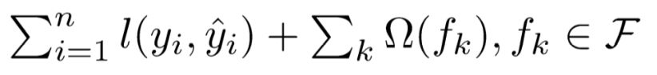
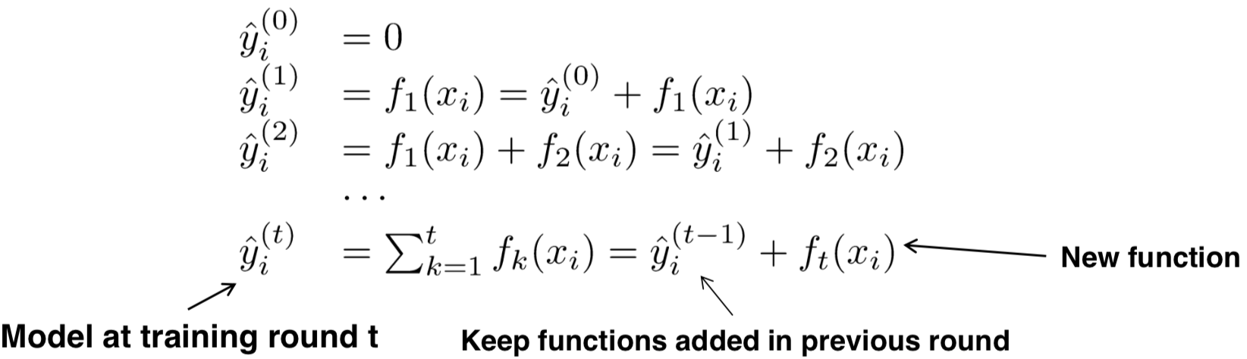
So How Do We Learn?
Objective Function:
Cant use SGD since they are trees not numerical vectors!
Solution: Additive Training (Boosting)
Start from constant prediction, add new function each time.

Slide 18
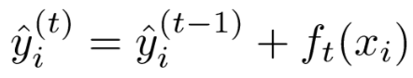
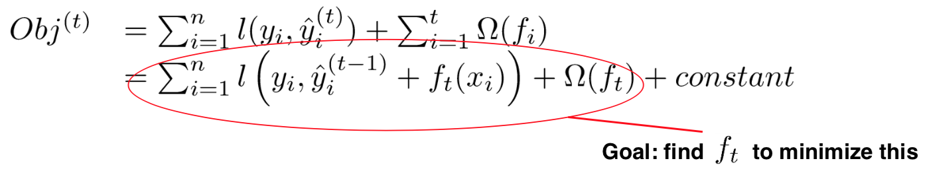
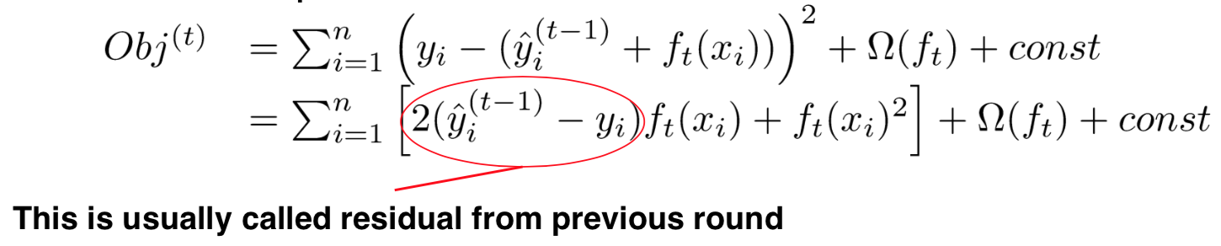
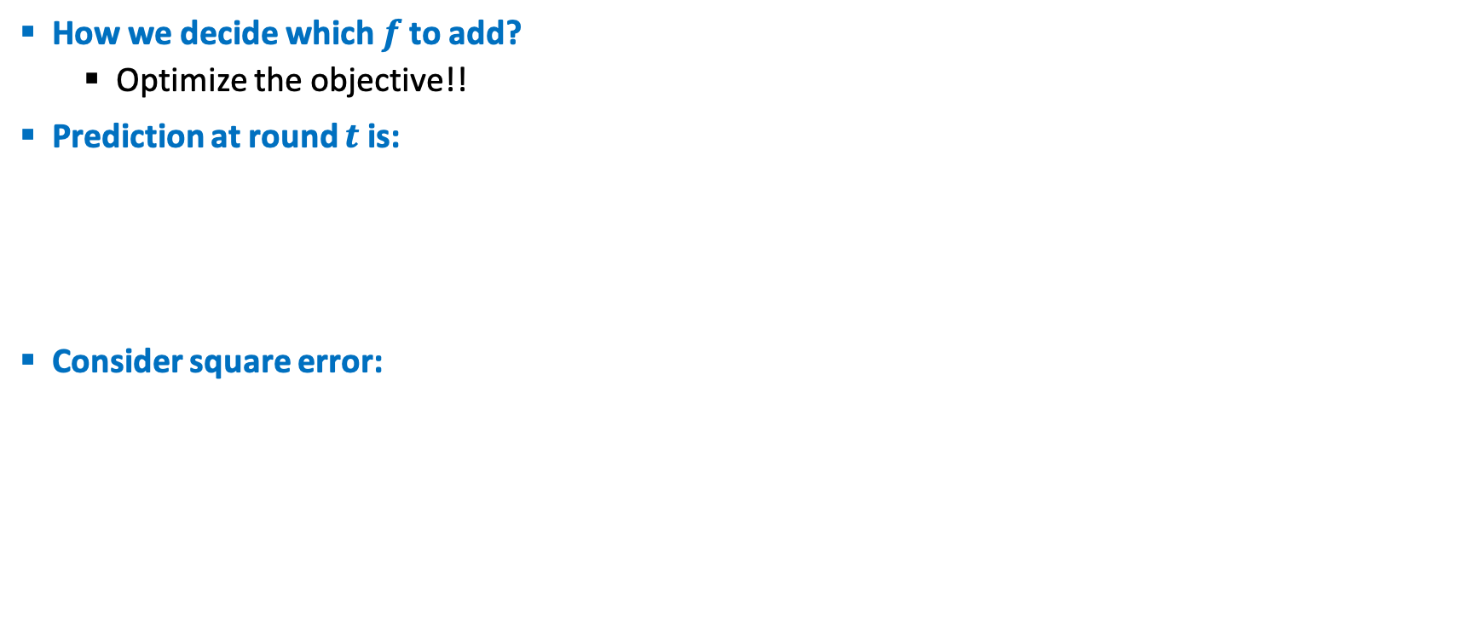
Additive Training (Boosting)
How we decide which $f$ to add?
Optimize the objective!!
Prediction at round $t$ is:
Consider square error:

Slide 19
Taylor Expansion for Approximation
Goal:
Seems still complicated except for the case of square error
Take Taylor expansion of the objective
Recall :
Define :
If you are not comfortable with this, think of square error:
Compare to what we got in previous slides.

Slide 20
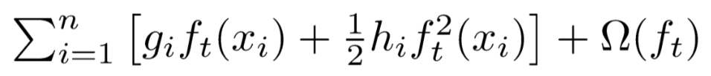
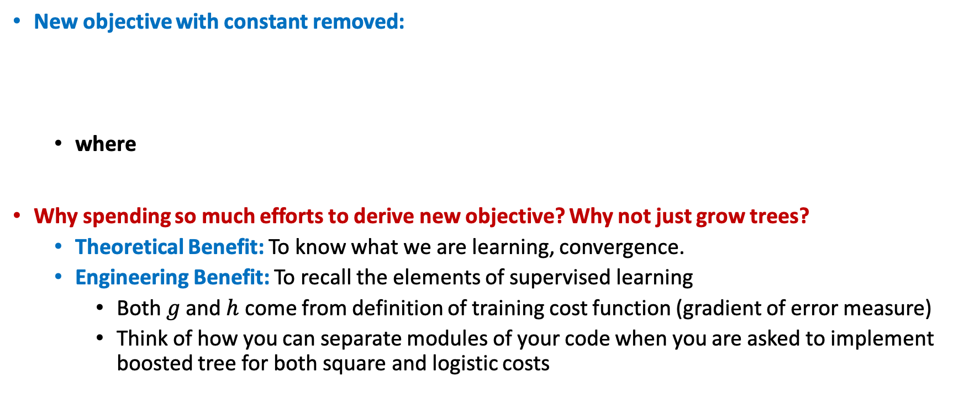
New Objective Function
New objective with constant removed:
where
Why spending so much efforts to derive new objective? Why not just grow trees?
Theoretical Benefit: To know what we are learning, convergence.
Engineering Benefit: To recall the elements of supervised learning
Both $g$ and $h$ come from definition of training cost function (gradient of error measure)
Think of how you can separate modules of your code when you are asked to implement boosted tree for both square and logistic costs

Slide 21
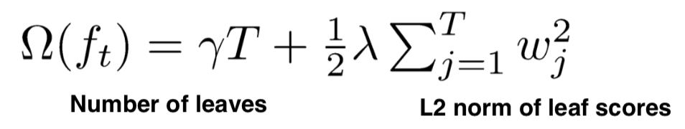
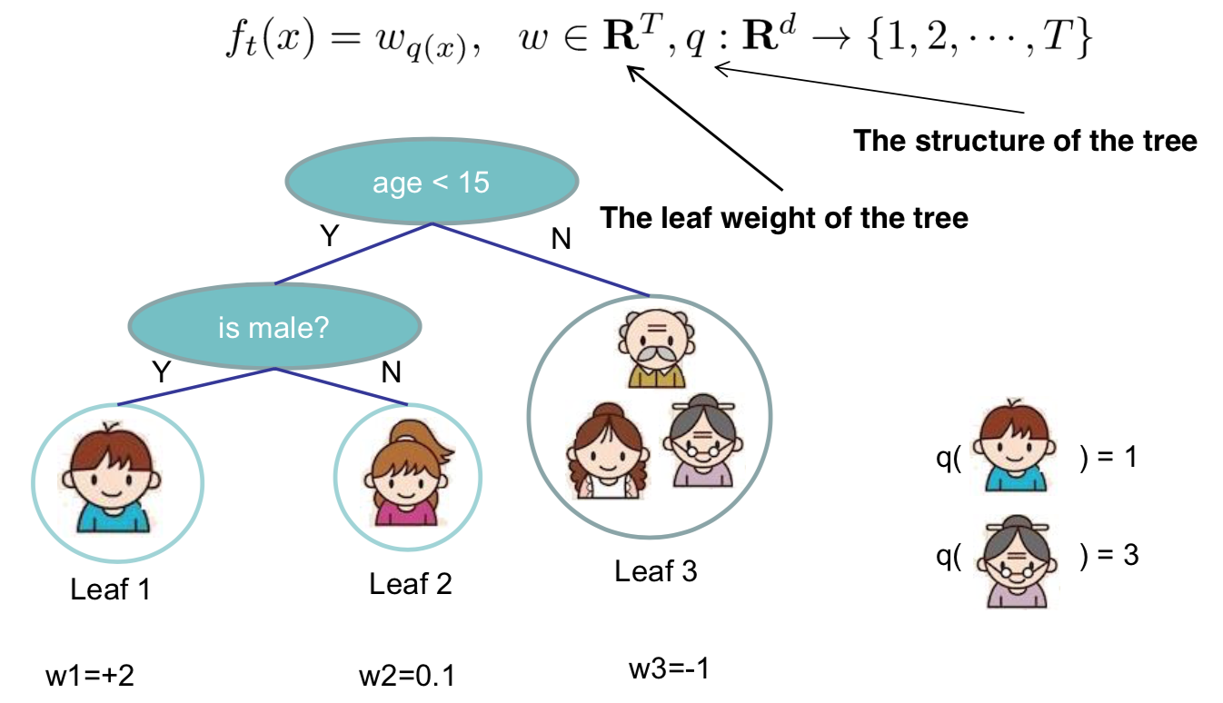
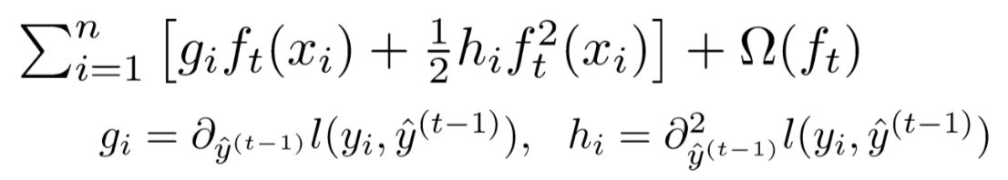
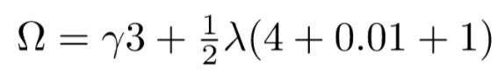
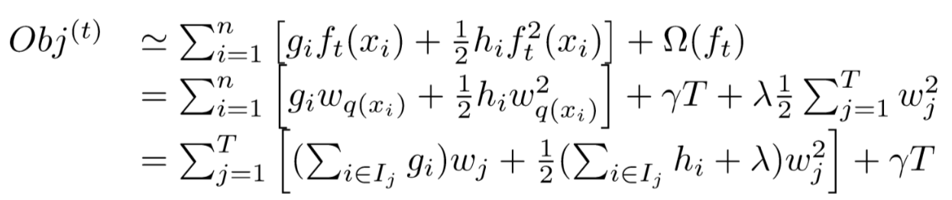
Refine Definition of the Tree
We define tree by a vector of scores in leafs, and a leaf index mapping function.
Define complexity as (this is not the only possible definition):
New Objective:
Regroup by Leaf:
A Sum of T independent quadratic function!

Slide 22
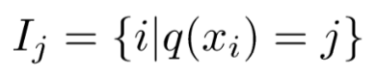
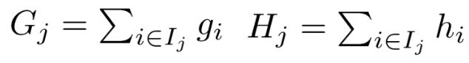
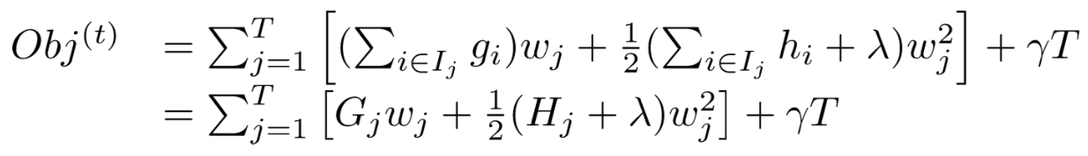
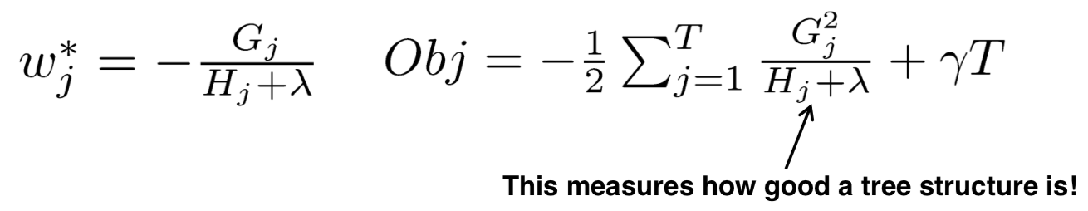
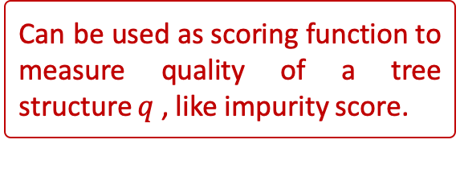
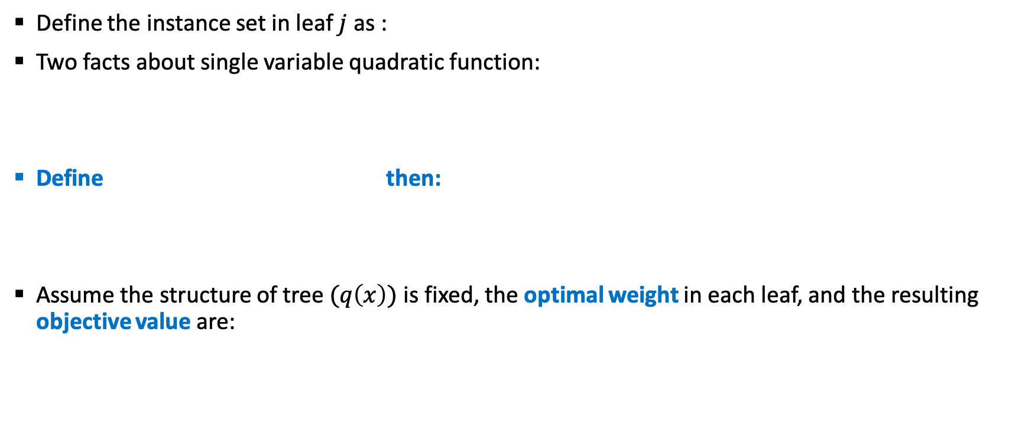
The Structure Score
Define the instance set in leaf $j$ as :
Two facts about single variable quadratic function:
Define then:
Assume the structure of tree $(q\left(x\right))$ is fixed, the optimal weight in each leaf, and the resulting objective value are:
Can be used as scoring function to measure quality of a tree structure $q$, like impurity score.

Slide 23
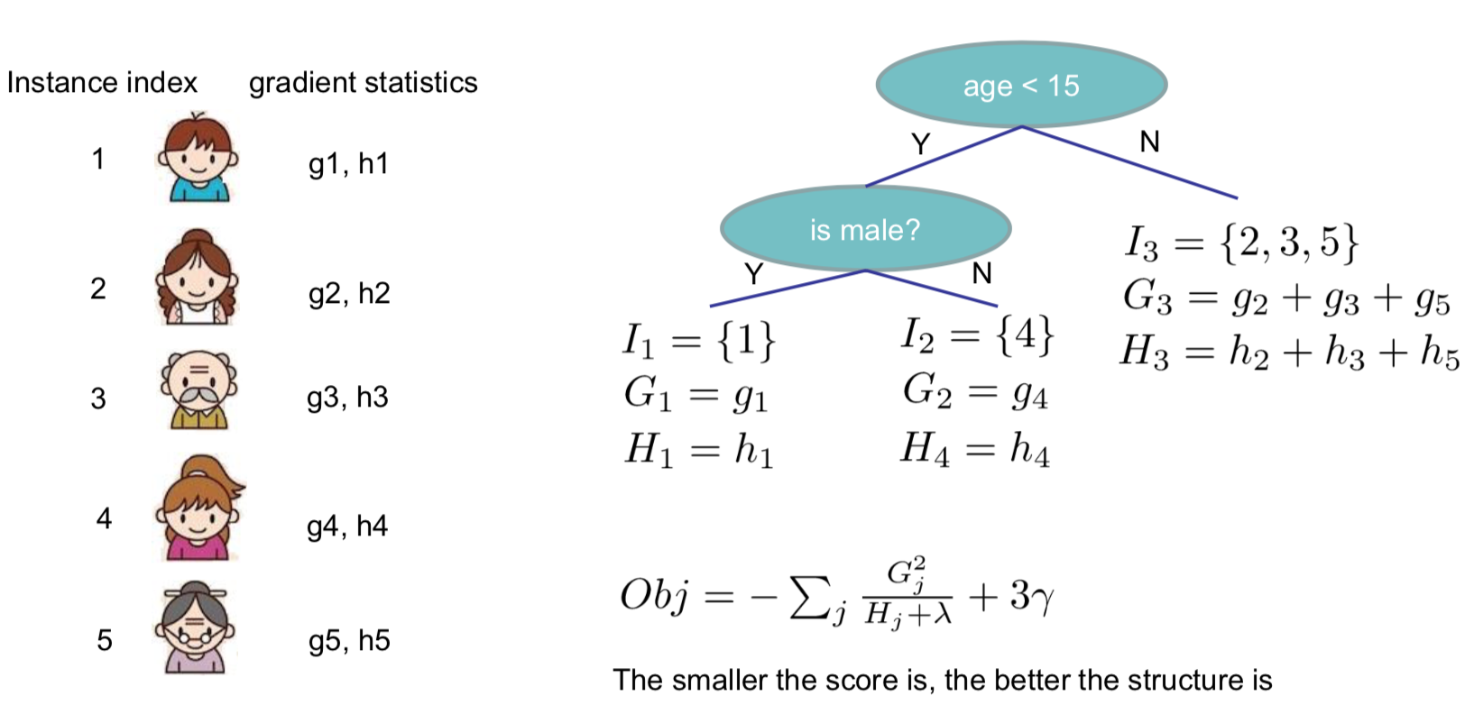
The Structure Score Calculation

Slide 24
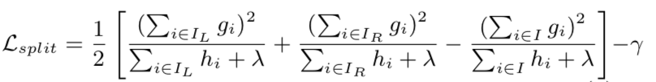
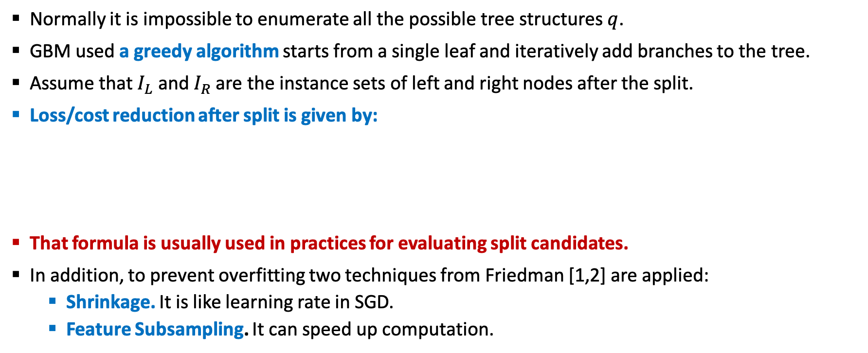
Exact Greedy Algorithm
Normally it is impossible to enumerate all the possible tree structures $q$.
GBM used a greedy algorithm starts from a single leaf and iteratively add branches to the tree.
Assume that $I_{L}$ and $I_{R}$ are the instance sets of left and right nodes after the split.
Loss/cost reduction after split is given by:
That formula is usually used in practices for evaluating split candidates.
In addition, to prevent overfitting two techniques from Friedman [1,2] are applied:
Shrinkage. It is like learning rate in SGD.
Feature Subsampling. It can speed up computation.

Slide 25
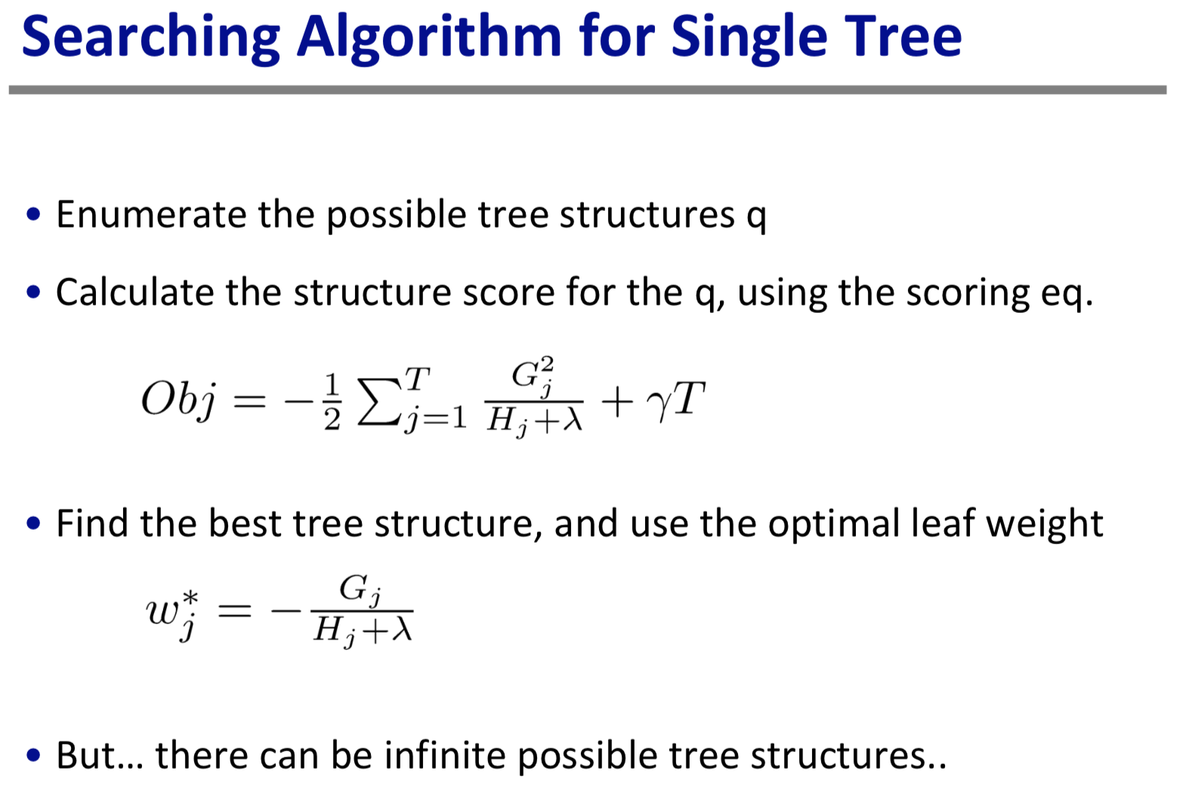
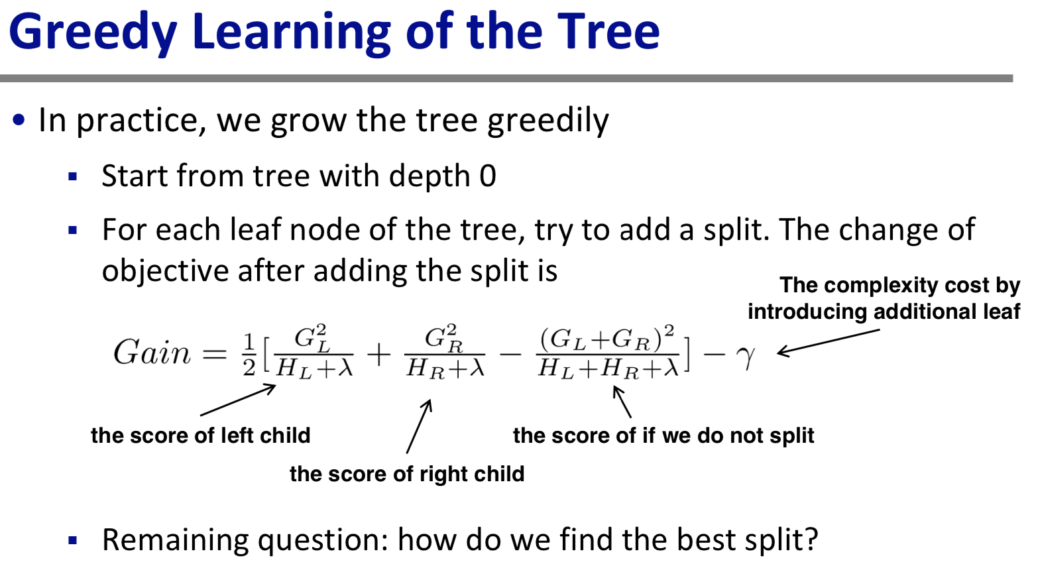
Searching and Greedy Algorithms

Slide 26
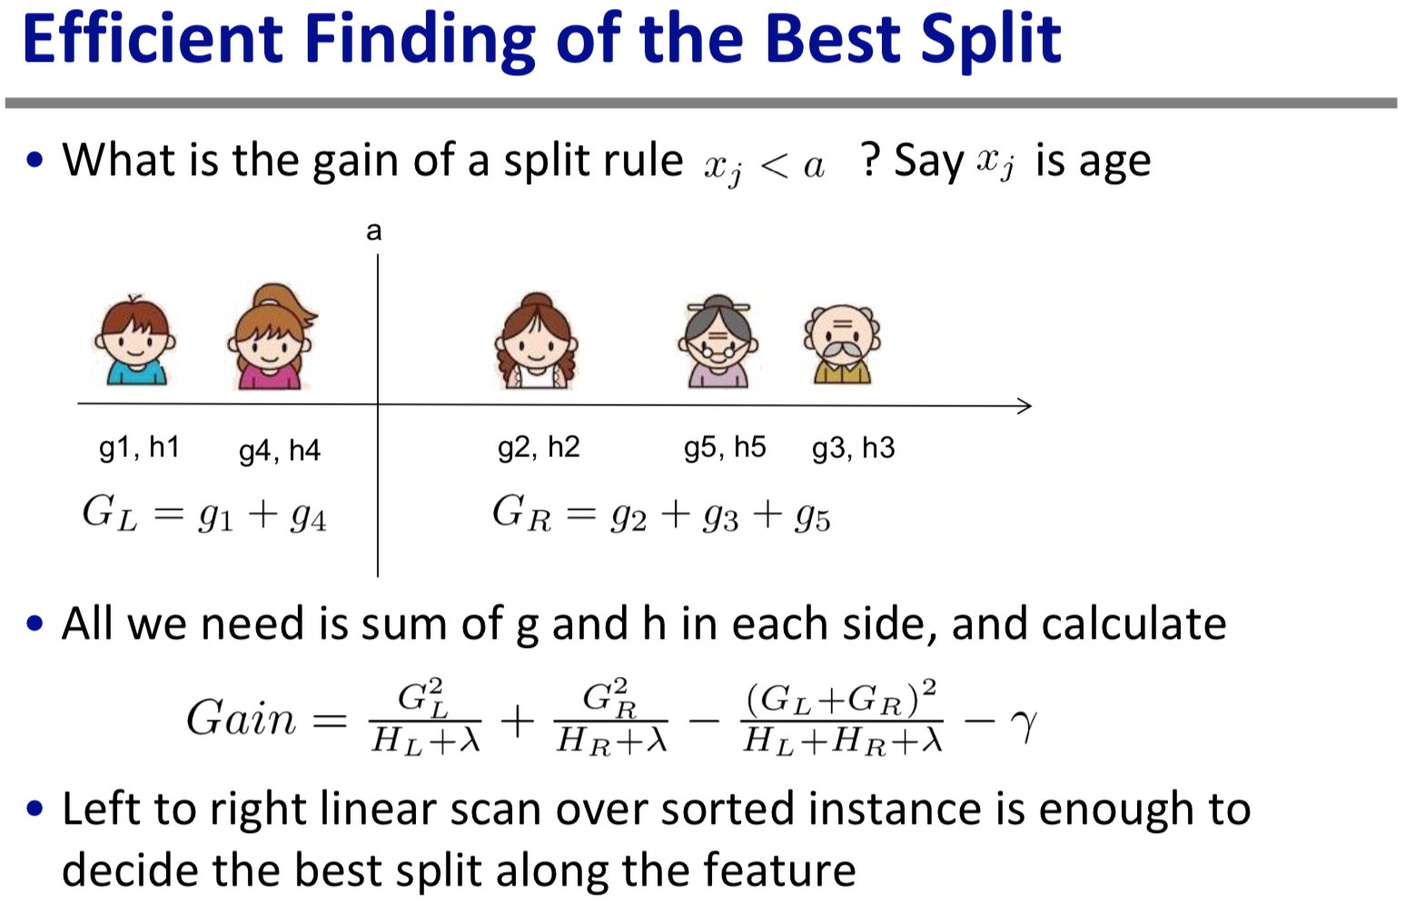
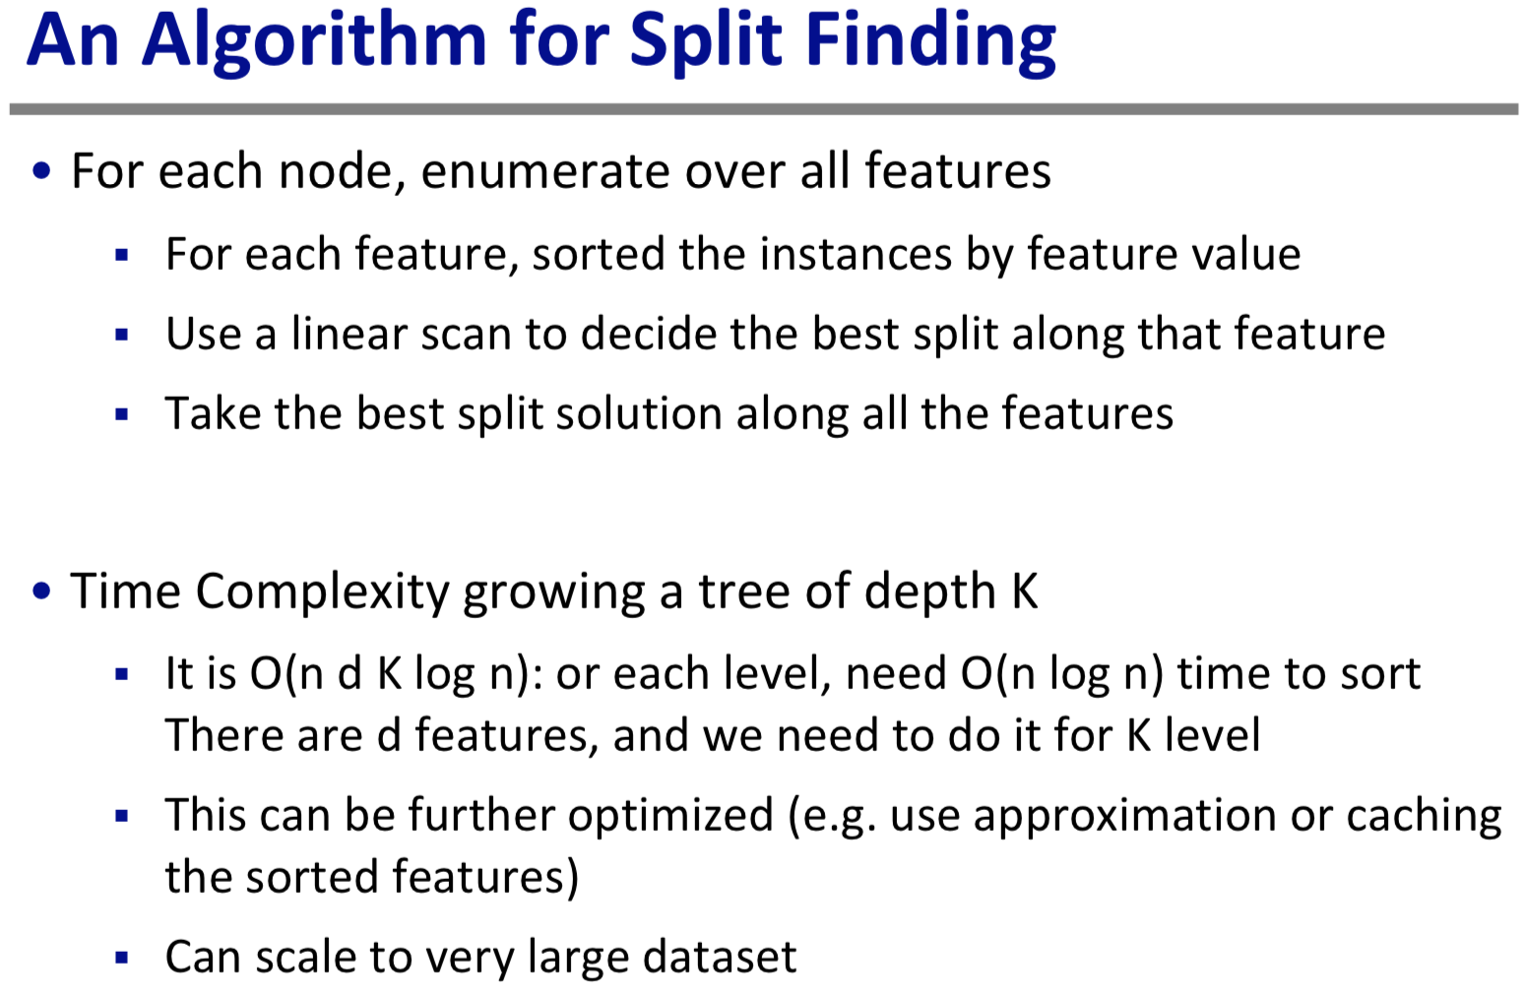
Split Finding Algorithm

Slide 27
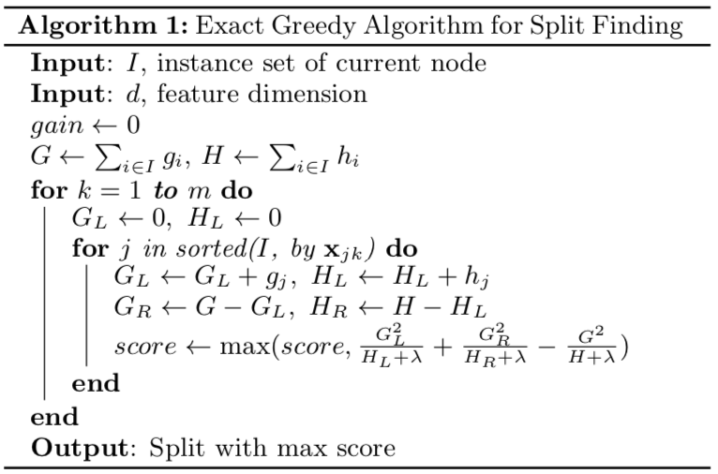
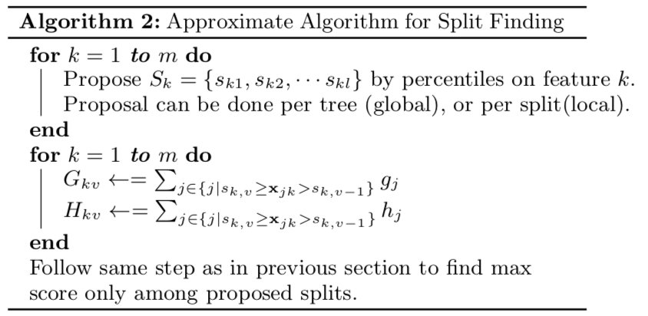
Exact Greedy Algorithm
Notes:
The exact greedy algorithm is shown in Alg. 1. It is computationally demanding to enumerate all the possible splits for continuous features. In order to do so efficiently, the algorithm must first sort the data according to feature values and visit the data in sorted order to accumulate the gradient statistics for the structure score in Eq (7).

Slide 28
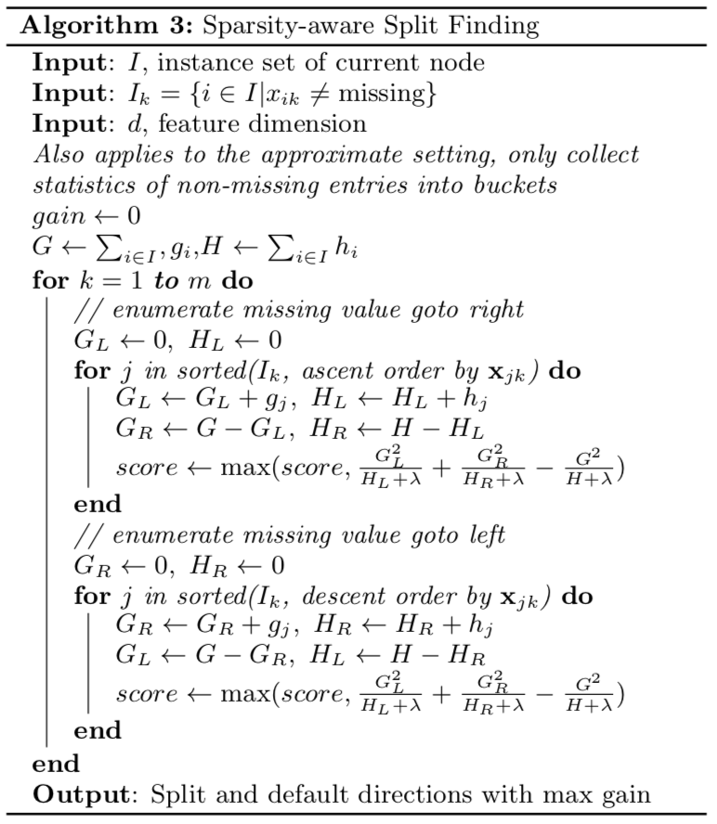
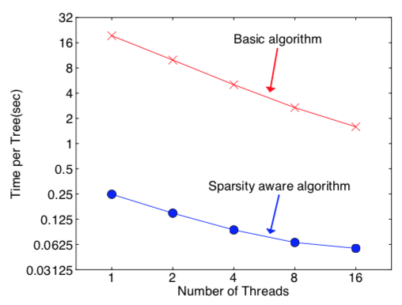
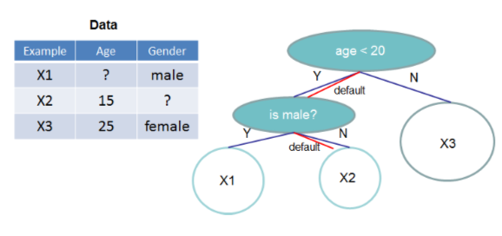
Sparsity-Aware Split Finding
It is common data is sparse due to:
Presence of missing values
Frequent zero entries
One-hot encoding
How to make algorithm aware of sparsity?
Solution: Tree structure with default direction

Slide 29

Pruning and Regularization
The gain of split, it can be negative!
When the training cost reduction is smaller than regularization
Trade-off between simplicity and predictiveness
Pre-stopping
Stop split if the best split have negative gain
But maybe a split can benefit future splits..
Post-pruning
Grow a tree to maximum depth, recursively prune all the leaf splits with negative gain

Slide 30


Categorical Variables and Time Series Data
Work with Categorical Variables
Work with Time Series Data

Slide 31

Recap: Boosted Tree Algorithm

Slide 32
Key Concepts
Supervised Learning
Separation of Model, Parameters, Objective Function, Regularization
Generalization Trade Off (VC Dimension and Bias-Variance)
Decision Tree and CART Ensemble Model
Gradient Boosting Algorithm
Exact Greedy Algorithm
Sparsity-Aware Split Finding
Pruning and Regularization
Summary

Slide 33
Recall: XGBoost Parameters
max_depth (how deep is your tree?)
learning_rate (shrinkage parameter, "speed of learning")
max_delta_step (additional cap on learning rate, needed in case of highly imbalanced classes)
n_estimators (number of boosting rounds)
booster (as XGBoost is not only about trees, but it actually is)
scale_pos_weight (in binary classification whether to rebalance the weights)
base_score (boosting starts with predicting 0.5 for all observations, you can change it here)
seed / random_state (To reproduce results.)
missing (if you want to treat some other things as missing than np.nan)
objective (give callable that maps objective(y_true, y_pred) -> grad, hes)
Notes:
Normally you will not really tune this parameters, apart from max_depth (and potentially learning_rate, but with so many others to tune I suggest to settle for sensible value). You can modify them, e.g. learning rate, if you think it makes sense, but you would rather not use hyperopt / sklearn grid search to find the optimal values here.

Slide 34

Limitation of XGBoost
Cant work properly with complex data. Coz it is based on Decision Tree.
Harder to train compare to Random Forest.
Inappropriate for time series data. Eq. How to do k-fold validation.

Slide 35
Summary
The separation between model, objective, parameters can be helpful for us to understand and customize ML models.
The VC dimension and bias-variance trade-off applies everywhere, including learning in functional space.
We can be formal about what we learn and how we learn. Clear understanding of theory can be used to guide cleaner engineering implementation.

Slide 36

Home Work

Slide 37
Reference and Further Reading*
Mason et al., Boosting Algorithms as Gradient Descent in Function Space, 1999.
J.H. Friedman, Stochastic Gradient Boosting, 1999.
J.H. Friedman, Greedy function approximation a gradient boosting machine, 2001.
Tianqi Chen et al., XGBoost: A Scalable Tree Boosting System, arXiv:1603.02754v3, 2016.
Tianqi Chen XGBoost Documentation: https://xgboost.readthedocs.io/en/latest/index.html
Hastie et al., The Element of Statistical Learning, Chapter 10.

